Slide 1
Introduction to Concurrent Programming with GPUs
CUDA Keywords
Notes:
This video lecture will focus on the CUDA keywords, which are required and/or powerful.

Slide 2
CUDA Keywords Categories
Execution/Invocation Keywords
Threads, Blocks, and Grids
Memory
Notes:
There are 3 classes of CUDA keywords.
The first is the collection of keywords related to how/where CUDA code is invoked/executed.
The next are those keywords that describe the division of computation on CUDA hardware.
The last set of keywords are those concerning host/device memory.

Slide 3
Execution/Invocation Keywords
__device__ - Called from GPU context from and executed on GPU
__global__ - Called from CPU context from and executed on GPU
__host__ - Called from CPU context from and executed on CPU
Notes:
If you want to make sure your code is called from the correct location and executed where you want it. This shows the flexibility of CUDA code that you can use it somewhat interchangabiey in different contexts.
These keywords are part of the function signature, not how you call the function.
If you want your code executed on the CPU then use the __host__ keyword.
If you want code to execute on the GPU and be called from the CPU then use __global__ keyword.
Lastly, if you want to have hierarchical code on the GPU, then add the __device__ keyword to subordinate functions.

Slide 4
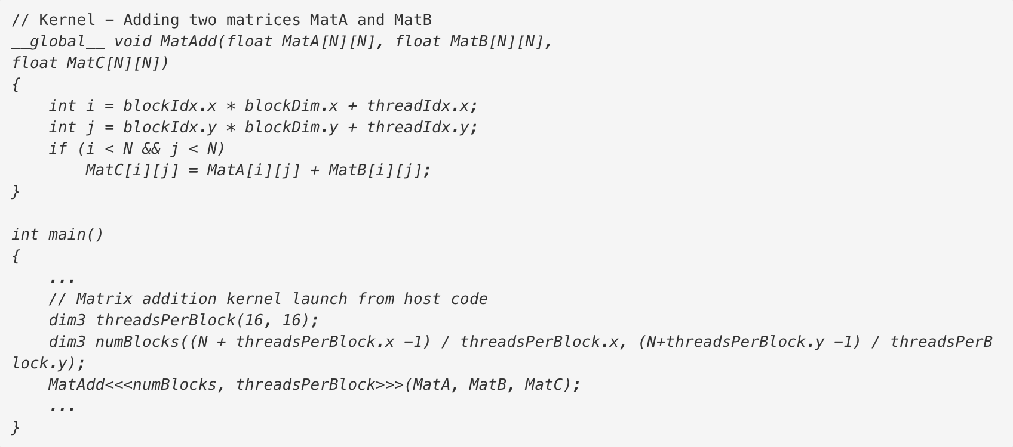
Threads, Blocks, and Grids
kernel<<<blocksPerGrid, threadsPerBlock, sizeOfSharedMemory (optional), cudaStream (optional)>>>(kernelArgs)
Threads – Each invocation of a kernel function executes on a single thread
Blocks – collections of threads that share memory and need to be a multiple of 32
Grids – collections of blocks that share some memory
[2]
Notes:
In order to determine how many threads per block, blocks per grid, size of shared memory, and an associated CUDA stream, as part of the triple less than and then greater than symbols.
To understand how that impacts the execution of code on the GPU, if you have N pieces of data and specify N threads per block (or N/m threads per block and m blocks with m blocks per grid) than each invocation of the kernel will occur in a single thread on a GPU.
This is not always the optimal execution pattern, if you need to share data/memory across threads.
Blocks are collections of threads that share memory and really should have a multiple of 32 threads as their thread sizes.
Grids add a 3-dimensional layout of threads, which can be helpful if data is 3-dimensional by nature.

Slide 5
Memory Keywords
int, char, float, etc. – Based on the hardware and number of threads registers will be used
const/__constant__ – constant memory keyword, will attempt to allocate based on hardware
shared/__shared__ – like constant keyword, but memory is shared within a block
__device__ - optionally indicates that device memories are intended for GPU
Notes:
Primitives, using the classic C/C++ standard primitive data type keywords, will attempt to use register memory as much as possible.
Using either the const or __constant__ keywords will attempt to use constant memory as much as possible.
There is a similar pattern with shared memory, note that it is not guaranteed that shared memory will all be block-allocated shared memory, it can happen that global memory.
__device__ is an optional keyword for indicated memory will be for devices and not CPUs.

Slide 6
Bibliography
[1] 2021. tutorialspoint.com. CUDA Keywords and Thread Organization. Retrieved from https://docs.nvidia.com/cuda/cuda-c-programming-guide/index.html - dim3.
[2] 2021. nvidia.com CUDA C Programming. Retrieved from https://docs.nvidia.com/cuda/cuda-c-programming-guide/index.html - dim3.

